Slide 1
Card Free Service
Face Recognition Using NMF
Adeeb Alqahtani
Hector Cabral
Heather Reyes
Wayne Kendrix
Notes:
Adeeb

Slide 2
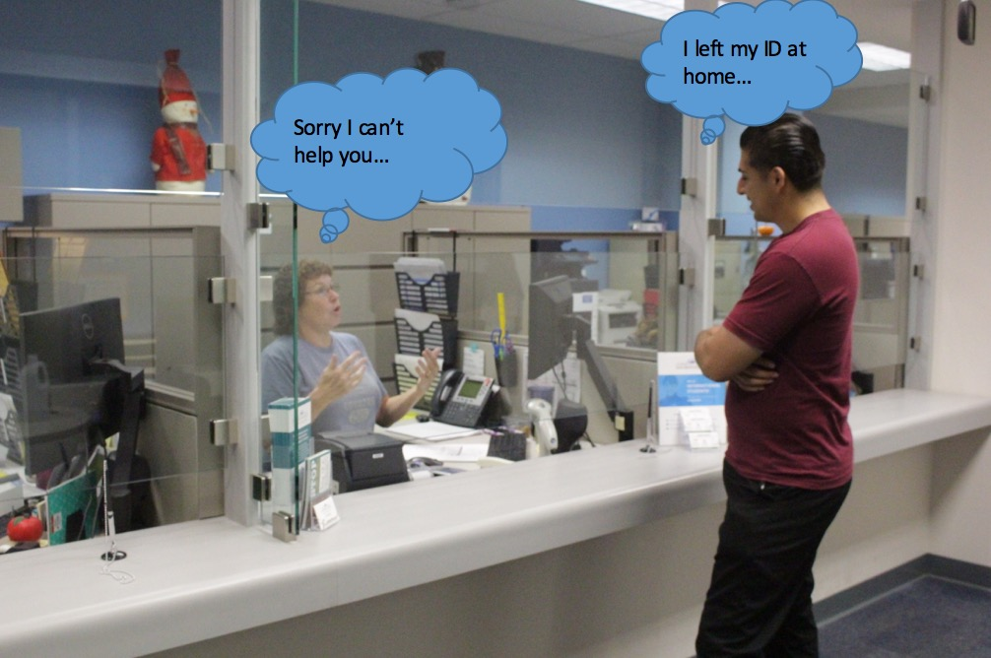
Student vs Financial Aid

Slide 3
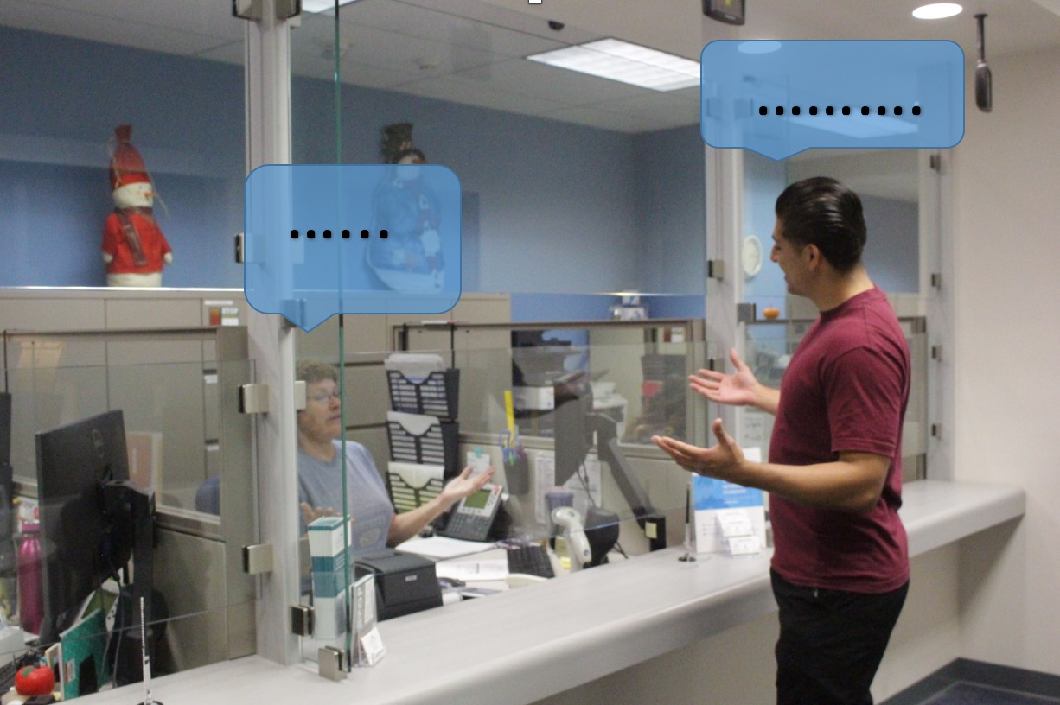
Student 0 - 1 Financial Aid

Slide 4



Inspiration & Significance
Scifi abstract idea turn to a reality
Social media & Movie Industry
Reduce human error
Improve security
Applied in different industries
Notes:
Hector

Slide 5


Background
Eliminate human error by replacing identification card with facial recognition.
Campus University Student ID Policy
Security, Automation, and Convenience
Notes:
Hector

Slide 6
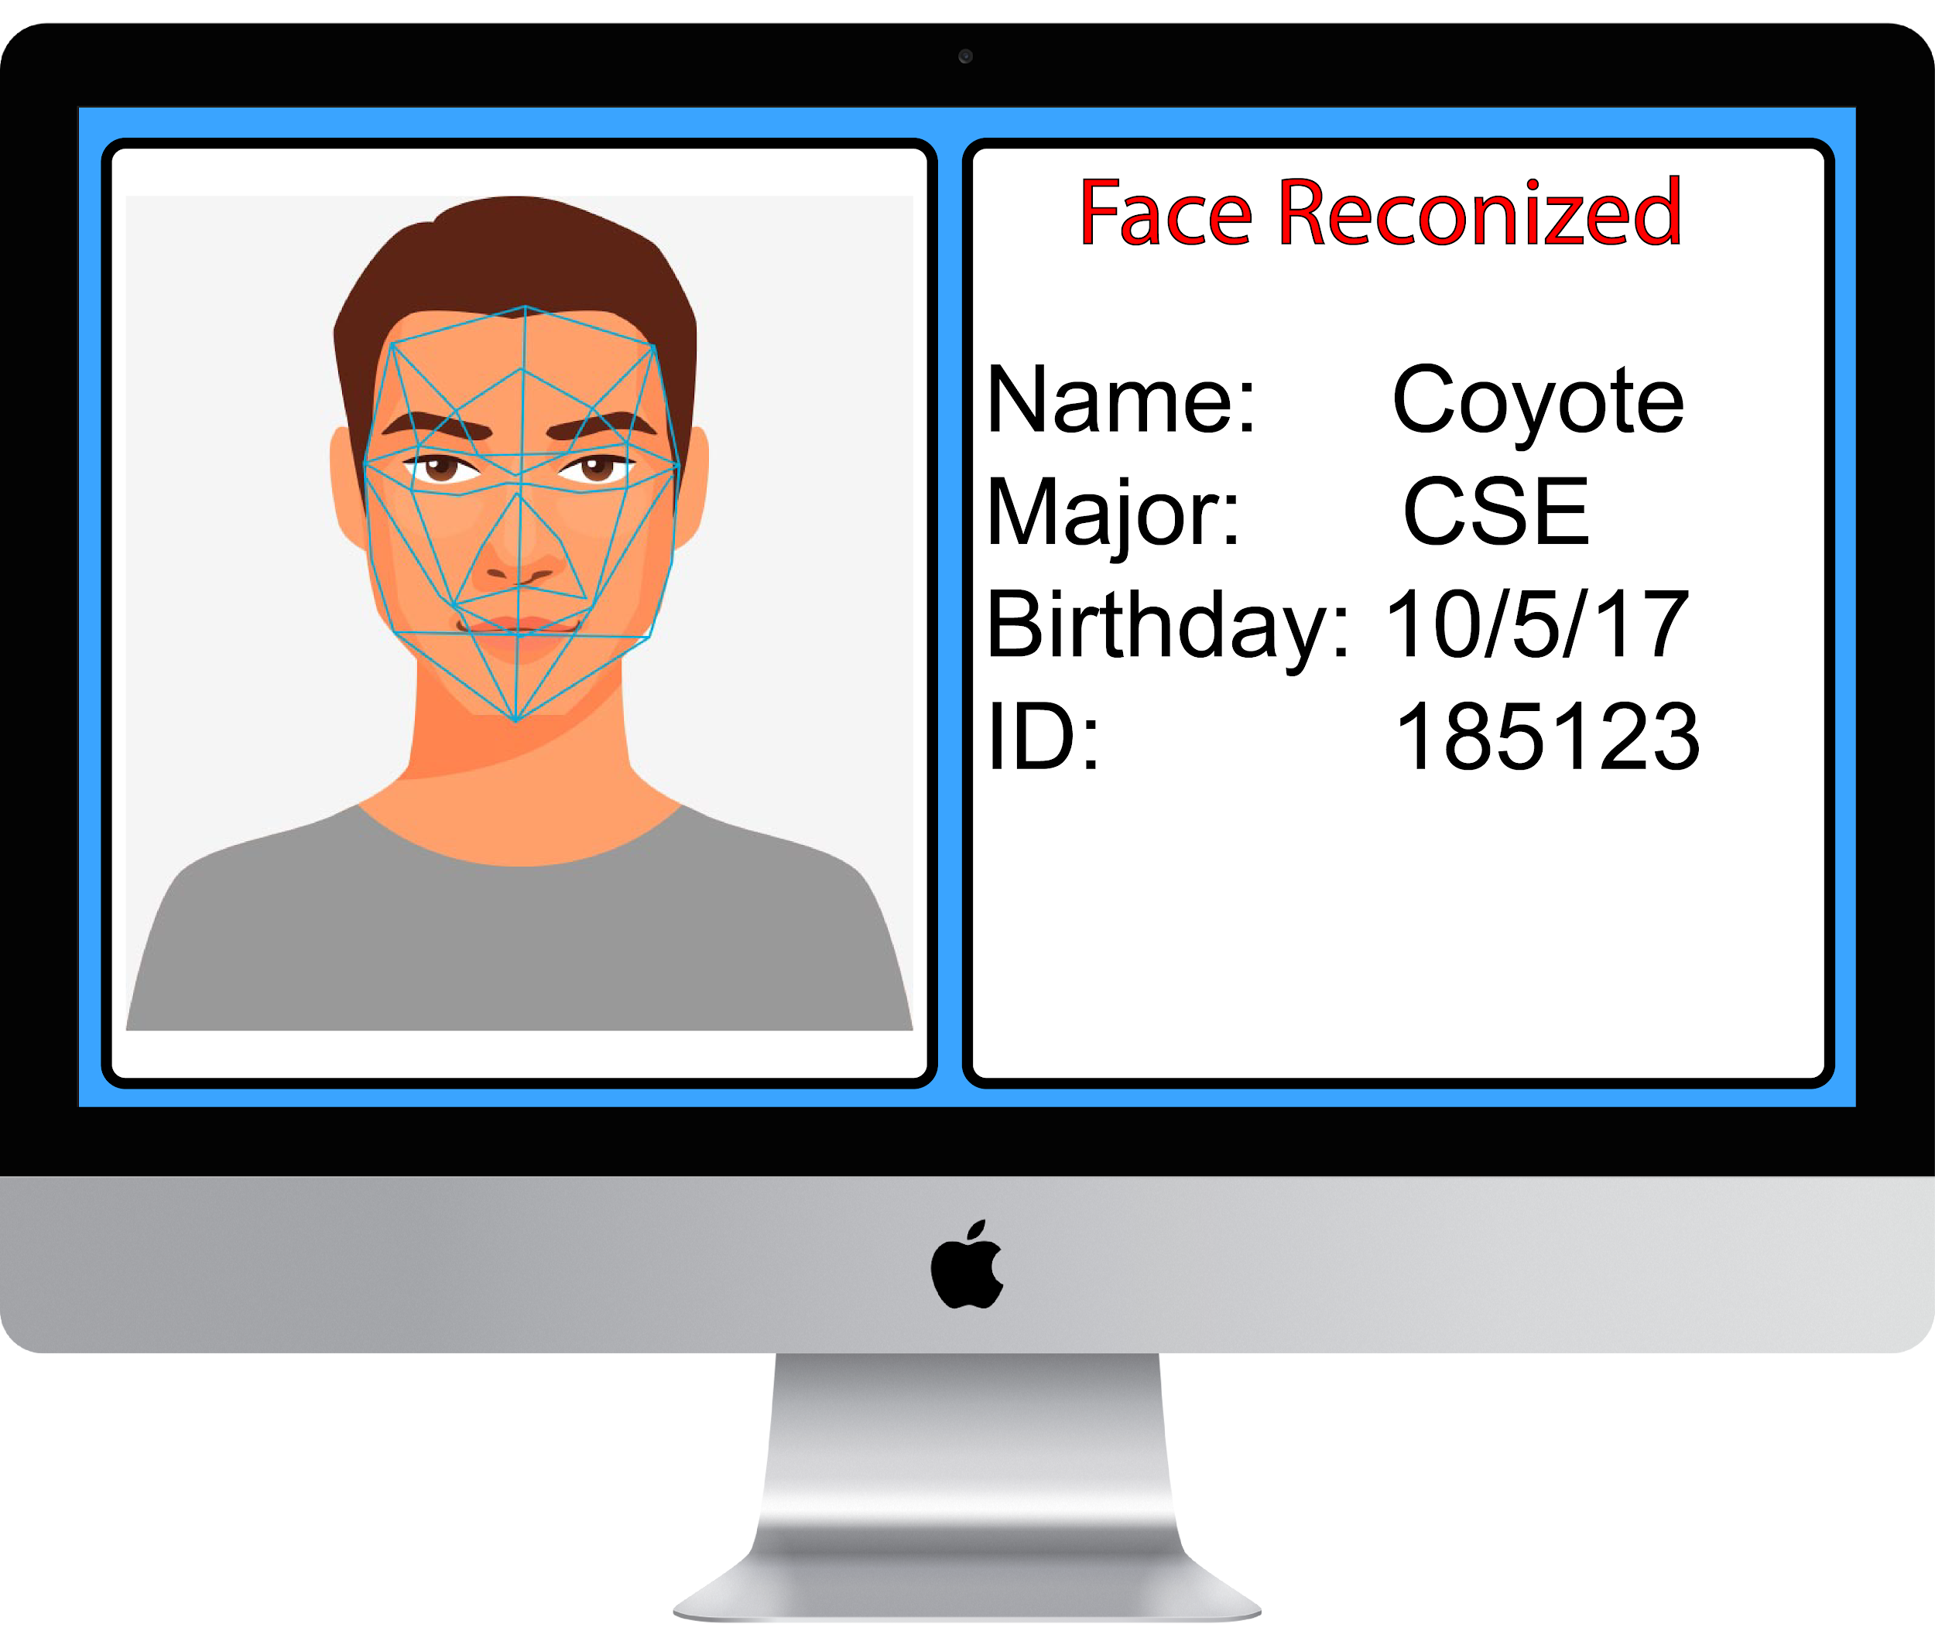
Introduction
The System:
Implement facial recognition and retrieve student data
Predefined database of student information
Non Negative Matrix Factorization
Notes:
Hector

Slide 7


Goals
Efficiency: card replacement
Cost: Less use of material and fees
Reliability: Security
Notes:
Hector

Slide 8



NMF vs PCA for Facial Recognition
-NMF utilizes an iterative approach which,
PCA does not, therefore increasing the efficiency(simplicity).
-NMF is “parts-based” making it more easier to
Interpret, where as PCA is holistic and broad.
-Therefore to achieve the goal of the project,
NMF was chosen to be most beneficial.
Notes:
Wayne

Slide 9
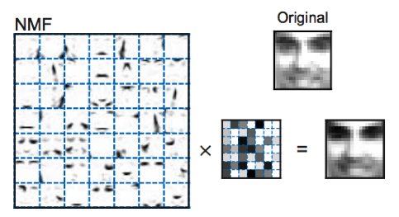
NMF Method
-Non-Negative Matrix Factorization
-Applying NMF for Facial Recognition
-Which can be achieved by representing
Localized features of distributed parts of face
Notes:
Wayne

Slide 10
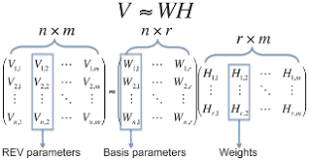
NMF Method Details
-Decompose matrix V into two matrices W and H
Elements of W and H must all be positive and
Subtraction is not allowed.
-Training images occupy columns of the
Data matrix V.
-When learning process is done, W = base images
H = encodings of those images.
Notes:
Wayne

Slide 11
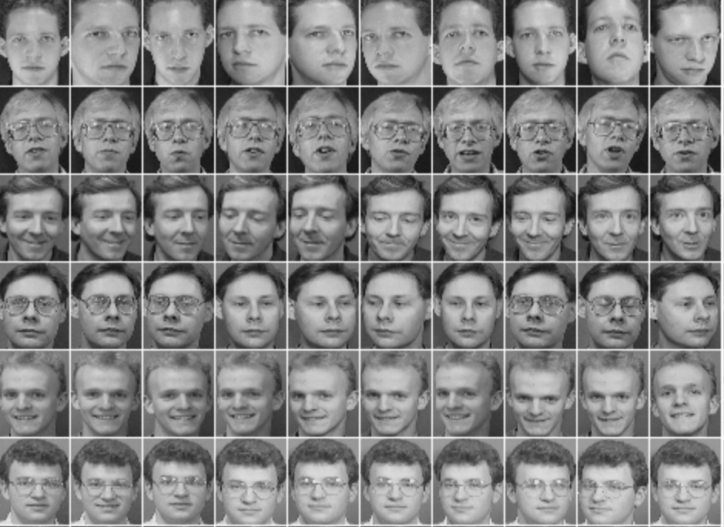
Tools
-Utilized the MATLAB software.
-Imported a pre-determined
database from AT&T
-Scholarly publications on applying NMF
w/ Facial Recognition
Notes:
Adeeb

Slide 12
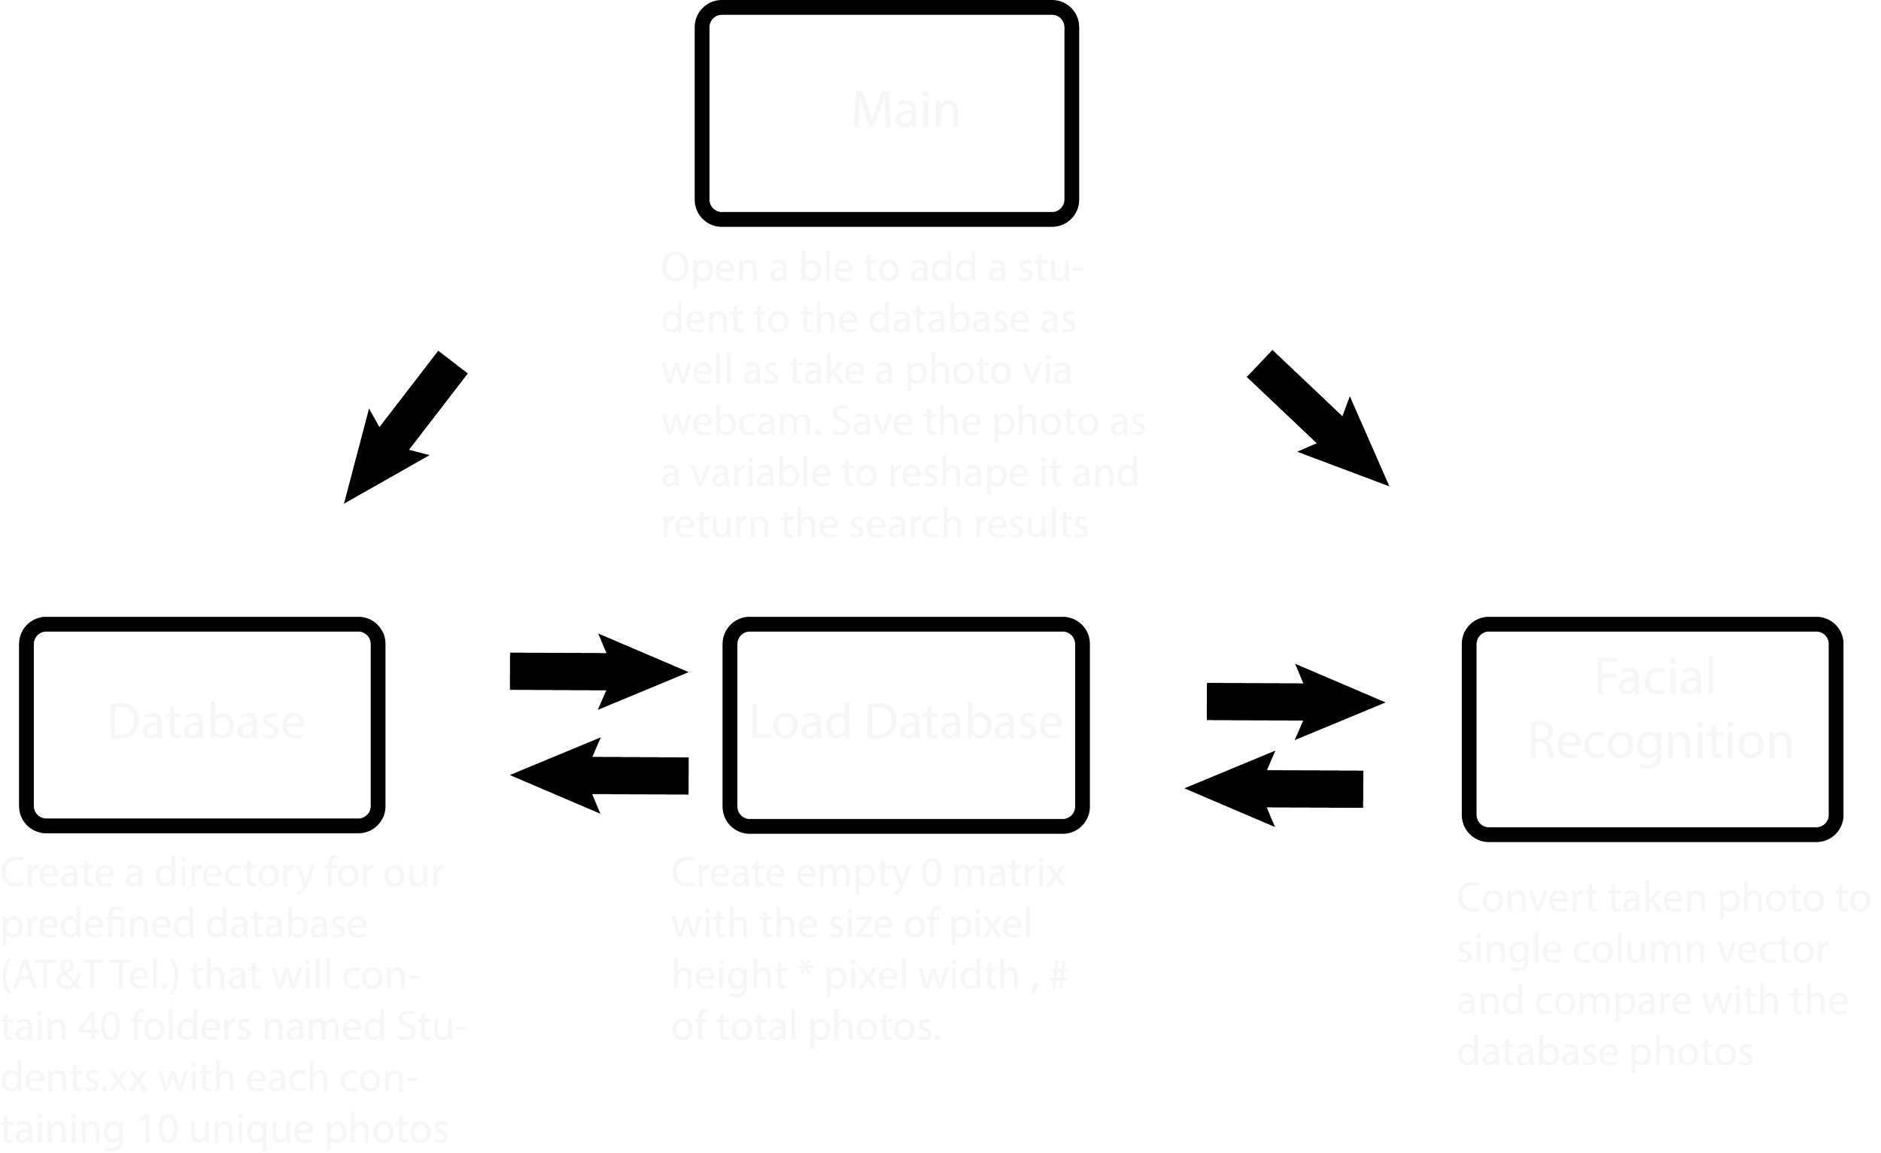
Procedure/Algorithm
Notes:
Adeeb

Slide 13

Demo
Notes:
Heather

Slide 14
RESULT: If a student
Notes:
Heather

Slide 15
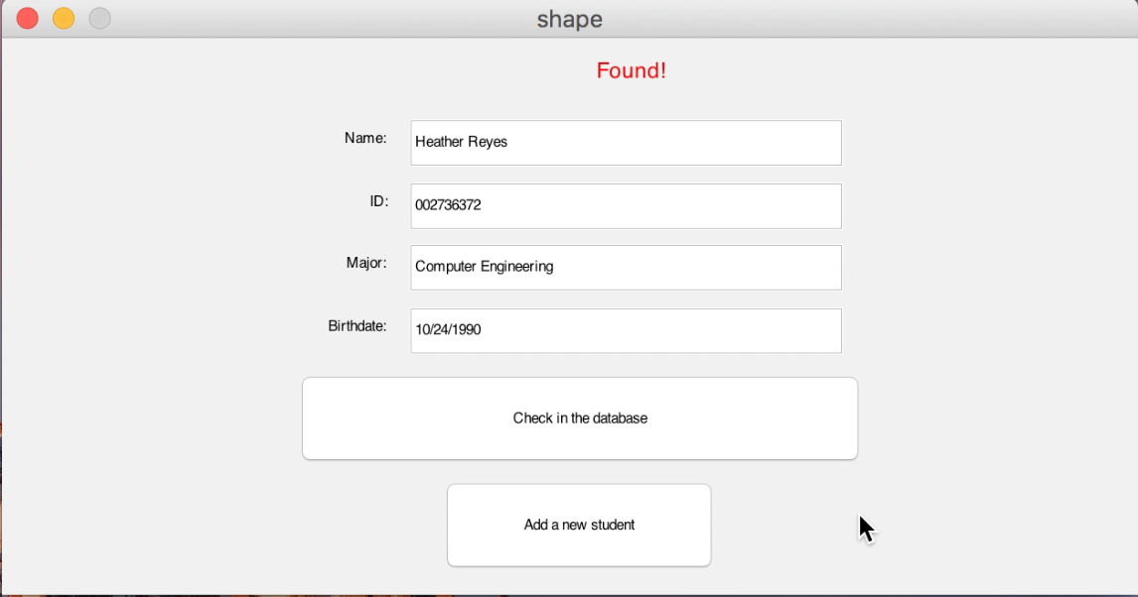
RESULT: If a student
Notes:
Heather

Slide 16
RESULT: If not a student
Notes:
Heather

Slide 17
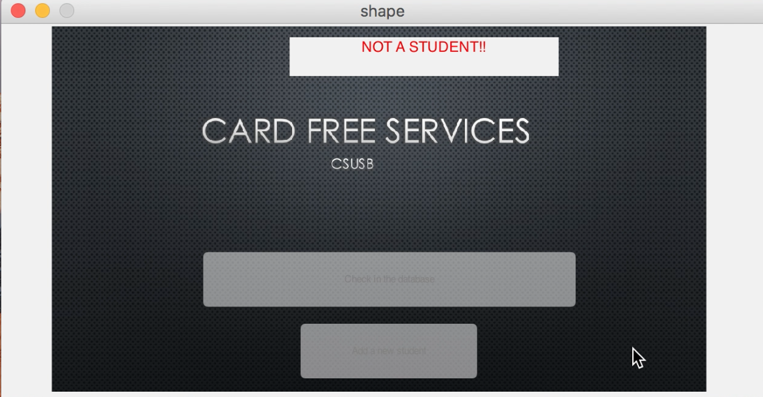
RESULT: If not a student
Notes:
Heather

Slide 18
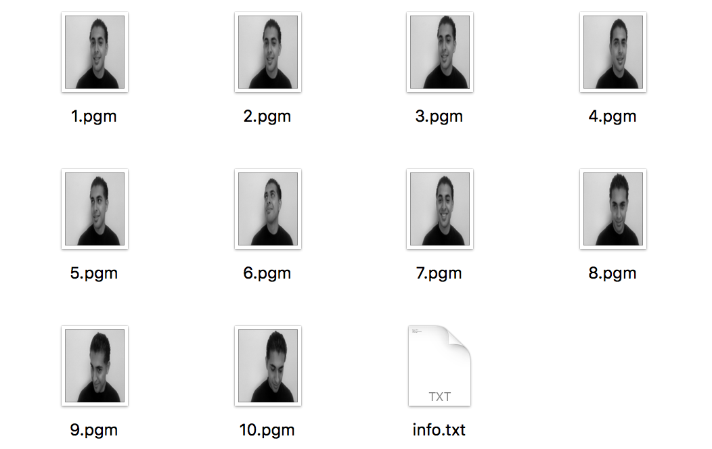
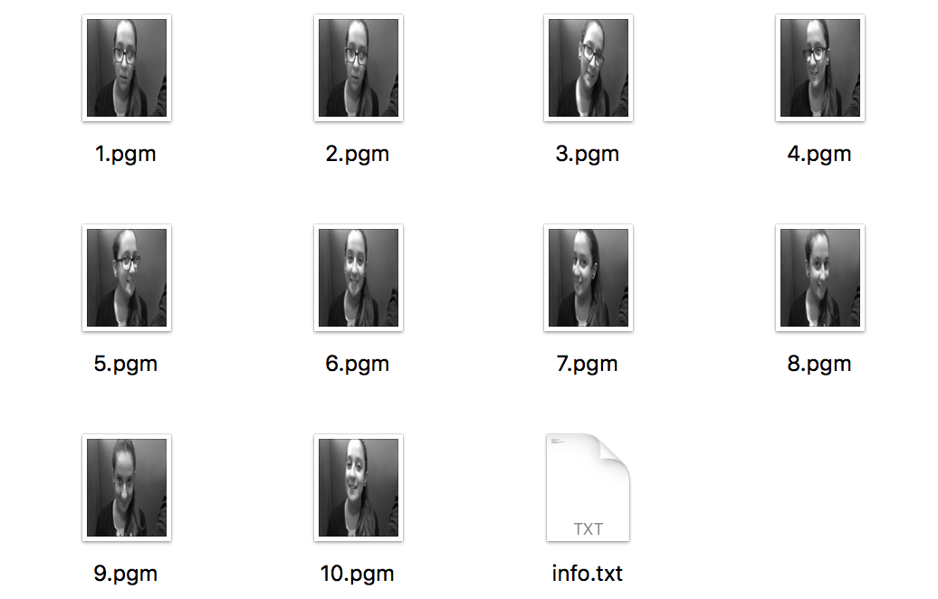
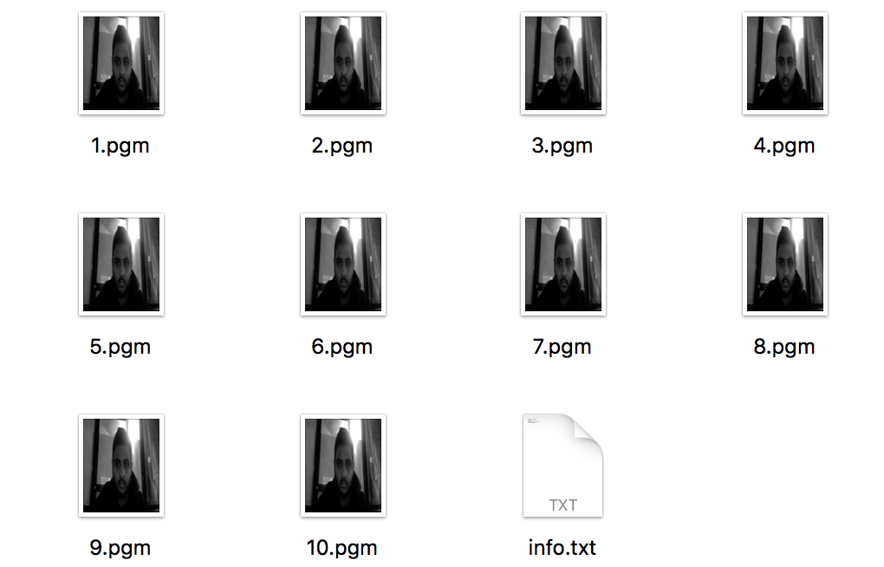
Data
Accuracy Rate - 87.5%
Test Data -
Number of tries - 40
Number of successful finds - 35
Notes:
Heather

Slide 19
Occurring Problems
Noise (Background):
It is hard to take a photo of the face only because we are using the webcam. The photo is always going to include the surroundings.
Loading database :
The code will load the images reshape them and then update the database every time it executes. This slows down the process time.
Matlab:
it is a powerful software but the GUI tool is not easy to work with.
Notes:
Heather

Slide 20

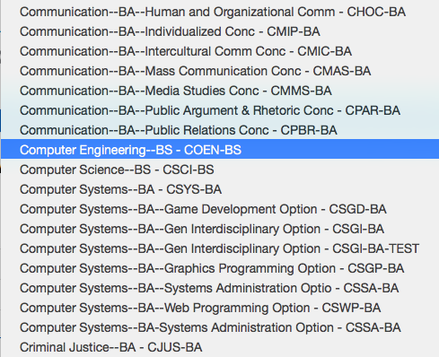

Future Improvements
Using different camera.
Using pop-up menu to enter the major and date of birth of the students instead of using text box.
Using a server for the database.
Notes:
Heather

